Slide 1
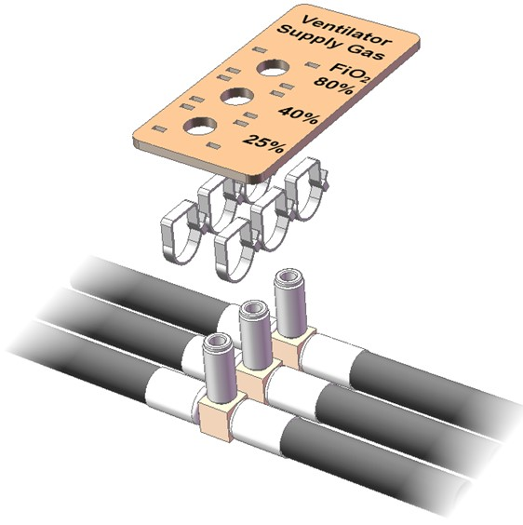
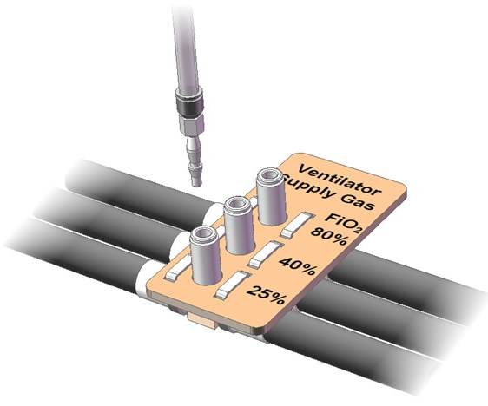
Pre-blended supply labelling
Ventilator 8mm PU tube
Cut or printed plate
Cable ties
(single row of 3 might suffice)
Compressed air hoses
(2, 3 or 4 off)
Clinician selects the prescribed FiO₂ concentration
Quick release connectors makes it easy to switch
This forms part of the ward infrastructure and not the ventilator itself

Slide 2
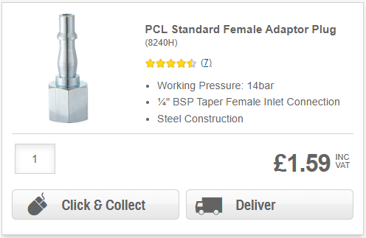
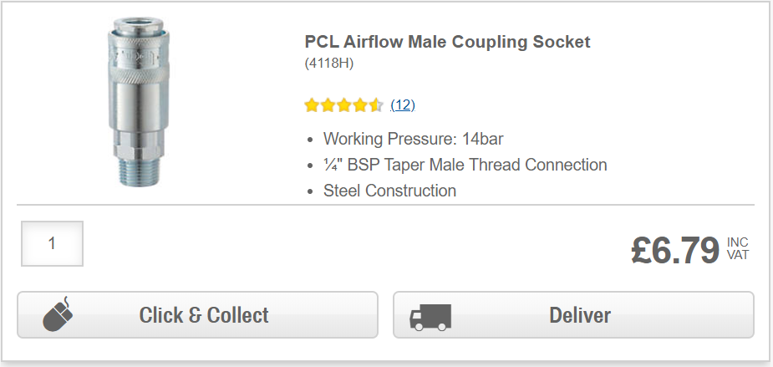

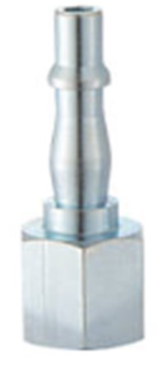
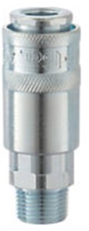
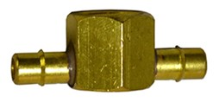
Proposed components
8mm x 2m PU tube to ventilator
Ventilator
There is no standard connector key for pre-blended gas.
Therefore, use a standard universal connector – which is readily available at the national level.
The risk of incorrect connections is mitigated by labelling.
If using an industrial connector, then flush clean with warn detergent water and rinse with clean water before use.
Conventional gas lines may be costly. Consider using standard pneumatic 16mm PU hoses or 15mm copper pipes.
Supply
Gas supply line

Slide 3
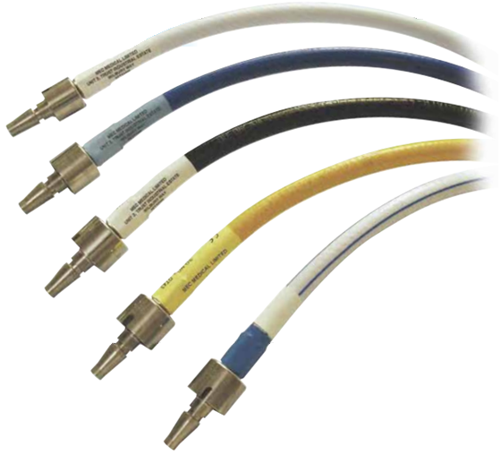
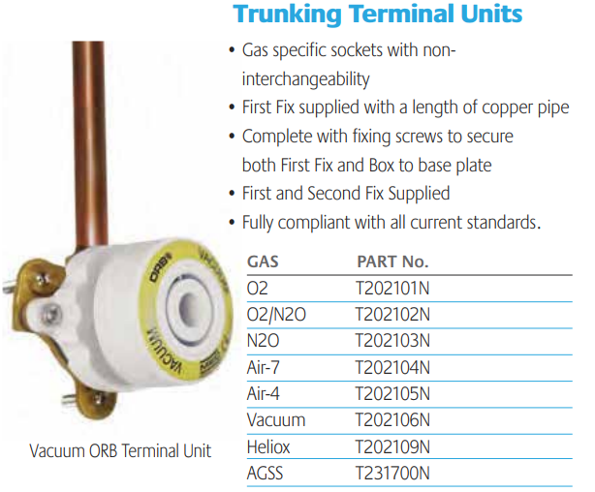
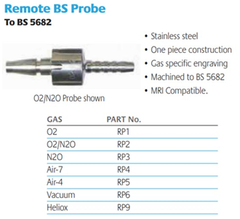
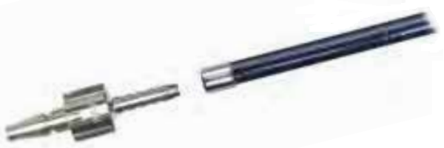
Standard medical gas systems
Hoses are colour coded
Collar forms a key that prevents wrong connections
NOT REQUIRED
Hose is pushed over barbs and clamped
Beware of incompatibility between British, German, Scandinavian, US and Japanese standards

